Slide 1
FANGO
. . .
Your Image Translation App
Group 5: Blaise, Joe , Louise, Reece, Inez

Slide 2

Intro
Why we’ve decided to make FANGO?
Notes:
1 min

Slide 3
Problem
Text Based Translation Apps
Two steps of image recognition and translation to another language
Notes:
Currently to translate something into another language, you need to know what the thing you’re translating is called in your native language, and use a text-to-text translation software to translate it into a different language. This changes when you don’t know what the object is, and you will need to add an extra step and use an image identification software before you can translate it. This is cumbersome and requires multiple apps to accomplish.

Slide 4
Solution with FANGO
Take a picture
Translate & Learn
Notes:
Our solution for this is Fango, a mobile-first app which will identify and translate an object for you to any language in real time using an photo uploaded or taken from your device camera.

Slide 5

Core Features
Image Translation
User History
Translate image to words and sentences in both english and a specified language
Translated using OpenAI API
Access previously searched images and terms
Example Sentences
Example sentences in specified language in easy, medium, and hard difficulties
Notes:
Our core features include:
Image translation to translate an image to words and sentenced in both english and another specified language, powered by OpenAI API
We also have a search history, so users can access previously searched translation results
And finally, we have example sentences of the language of choice in easy, medium, and hard difficulties to allow users to learn as they translate
And now onto Blaise for the Demo

Slide 6
DEMO
Let’s dive in!
Notes:
3mins
Make sure show core functionality
Explain why our demo meets project goals
Show a realistic user scenario to make the flow intuitice

Slide 7
Code & Tech
Highlights
Woooooohooo
Notes:
4mins (aim for 3.5mins)

Slide 8
Frontend
Functionality &
Challenges
Notes:
inez

Slide 9



Frontend Functionality
React
Tailwind
HTML/JS/CSS
Notes:
inez

Slide 10
Frontend Challenges
Data Handling with React
Notes:
inez

Slide 11
Frontend Challenges
Data Handling with React
maybe…
State?
Notes:
Inez
Initial thoughts

Slide 12
Frontend Challenges
Data Handling with React
import React, { useState } from 'react';
const [data, setData] = useState(0);
Notes:
inez
Code example for useState

Slide 13
Frontend Challenges
state vs context vs props
props
CONTEXT
state
Notes:
Inez
Coudlnt decide wheter use state or context or props -> turned out using all three is helpful

Slide 14
Frontend Challenges
state > context > props
const [data, setData] = useState<SignupData>
const Ctx = createContext<SignupCtx | null>(null);
<Ctx.Provider value={value}>{children}</Ctx.Provider>;
Notes:
Inez
Code example

Slide 15
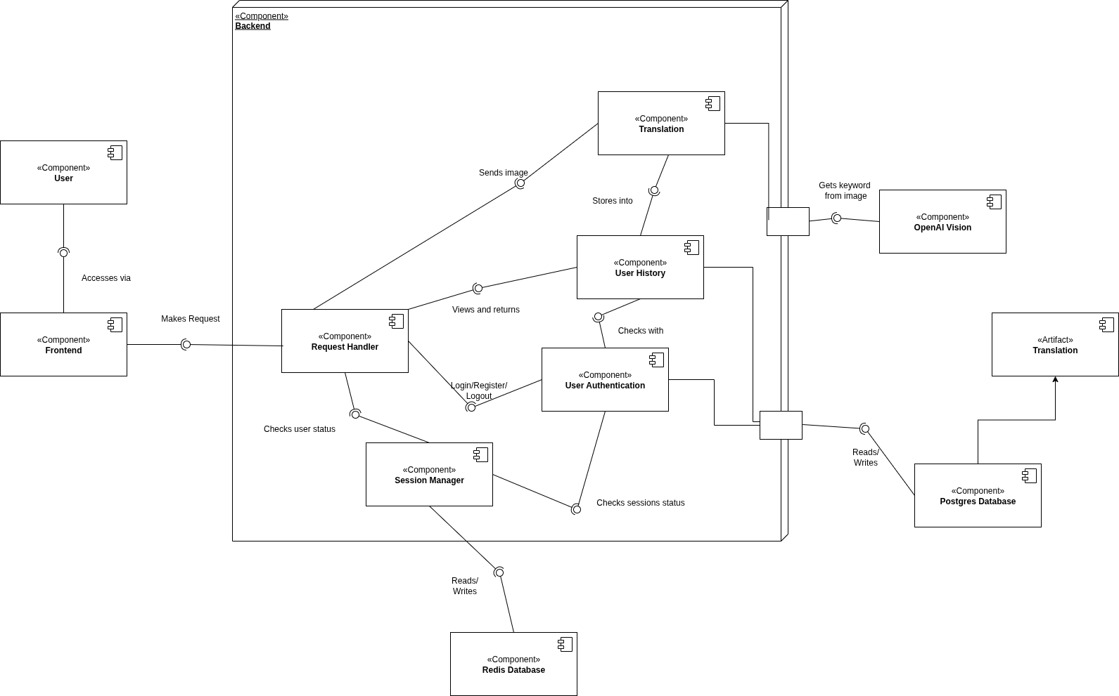
Notes:
inez
MAX 1min
The entire system is containerized using Docker, with separate services for the database, backend, frontend, and Redis.
Users interact with the Frontend, which sends requests to the Backend.
Requests are processed by first authenticating the user's session and checking their rate limits with Redis.
User Authentication ensures the user is logged in and hasn't exceeded allowed request rates.
The core feature, image translation, uses the Translation component, which sends images to OpenAI for keyword extraction.
Data is stored in a Postgres database, and caching is handled by Redis for session and rate-limit management.

Slide 16
Backend
Functionality &
Challenges
Notes:
Louise

Slide 17



Backend Challenges
Authentication
Image Translation
Notes:
Auth:

Slide 18
Handling Authentication
Challenge I: JWT Statelessness
Session token storage with Redis
Challenge II: DOS Vulnerability
Rate limiting
Challenge III: Frequent Redundant Queries
Redis caching
Notes:
Challenge 1: JWT’s statelessness hindered token revocation
To address this, we integrated Redis to store session tokens, allowing us to modify the session state and revoke tokens as needed.
Challenge 2:
To reduce the system’s vulnerability to DOS and minimize OpenAI token usage, we implemented rate limiting by storing rate limit keys for users anc checking them for each request.
Challenge 3: Our project’s nature required frequent database queries, which led to overhead.
We reduced this overhead by caching commonly accessed data in user session keys, improving performance.

Slide 19
Authentication Deviations
Original Vision
Final Vision
Notes:
The initial vision for AUTH was simply using JWT for session management, while rate limiting and caching were unanticipated features. The final solution integrated Redis to store JWT tokens and manage caching, sessioning, and rate limiting.

Slide 20
Backend Challenges
Authentication
Image Translation
Notes:
Image translation:

Slide 21
Handling Translations
Challenge I: Storing and linking images
Extensive testing
GET endpoint (ServeImage) to retrieve images
Challenge II: Unreliable OpenAI docs & image conversion
Reference latest OpenAI documentation
Conduct additional tests
Notes:
Image Translation:
Challenge 1: learning to store image files correctly in Docker volumes and linking them with the database.
With extensive testing, added a GET endpoint (ServeImage) to return images from the volume using file paths, we were able to manage this hurdle.
Challenge 2: unreliable OpenAI documentation and converting image to correct file type for OpenAI translation
To overcome this, we read latest OpenAI docs and conduct additional tests

Slide 22
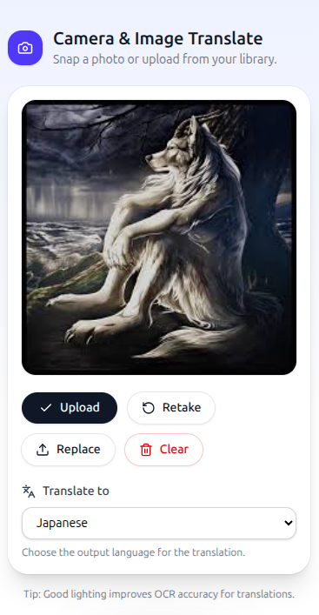
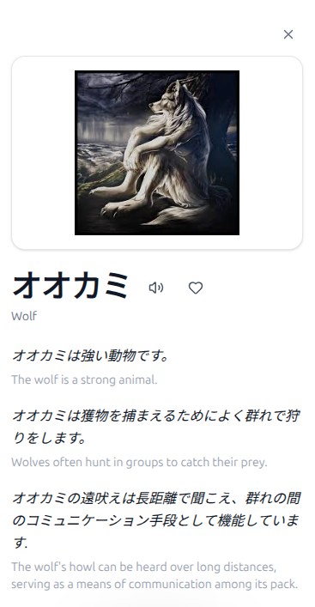
Translation Deviations
Translation
History ID
Notes:
The initial vision for IMAGE TRANSLATION was a POST endpoint to save images, perform OpenAI translation, and store results. The final solution consolidated everything into one POST request that also returns a translation history ID, which is used to show user history page.

Slide 23
Challenges &
Lessons
Boohoo….
Notes:
2mins

Slide 24



Challenges
Git Issues
Project Scope
Time Management
Notes:
Early on we had some collaboration issues. At that point we had not yet established clear practices such as doing code reviews or testing extensively with integrated features. This resulted in unnecessary time debugging our project.
We also were challenged by project scope. Early on we had ideas for big features that we were not able to get around to in the timeframe of this course. So we ending up making database models and frontend components that would not be used.
We definitely felt time management was a big challenge during this project as students with our own life schedule, it was sometimes difficult to coordinate our work especially if two of us were working on features that relied on each other.

Slide 25
Lessons
Code Reviews
Testing
Focus on MVP
Utilize Task Tracking
Notes:
We learned that for us to fix our collaboration issues, as a team we needed to implement a standard process for contributing to the project such as doing pull requests and code reviews and doing extensive testing before merging features.
We also learned that focusing on the key features first, prevents defining an unrealistic scope. Early attempts to include too many features taught us the importance of prioritization to deliver a functional product within the deadline.
Also, putting your tasks on trello and reading your teammates tasks on trello helped our team stay on track and understand what tasks needed to be prioritized. This also helped reduce confusion and overlap ensuring that we were collaborating effectively as a team.

